Slide 1
Image Classification Military and non-military vehicles
Wendy Chan

Slide 2
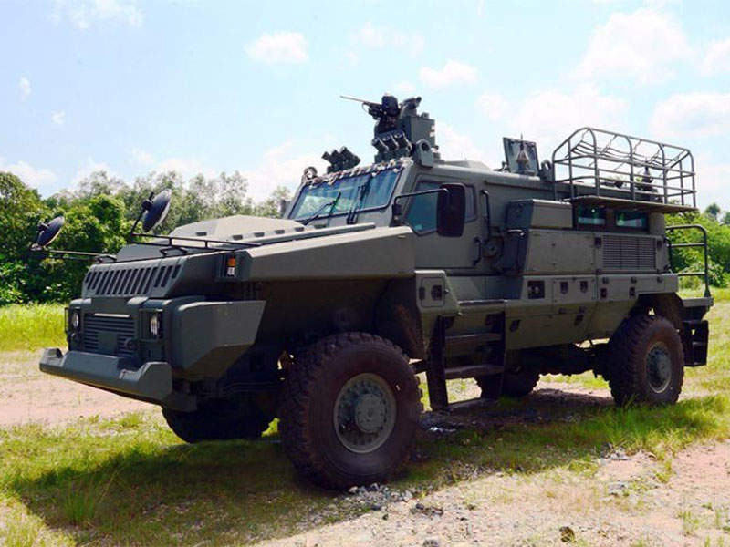
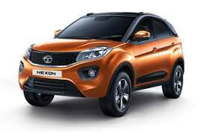
Goal
To identify military vehicle when given an image of vehicle

Slide 3
Data Source
Input source
Download “military vehicles” and “non-military vehicles” images from Google image search
Manual “eye-ball” to remove unrelated images
Output
Manually sort image into 2 folders for training
Military vehicle - 674
Non-military vehicle - 732

Slide 4
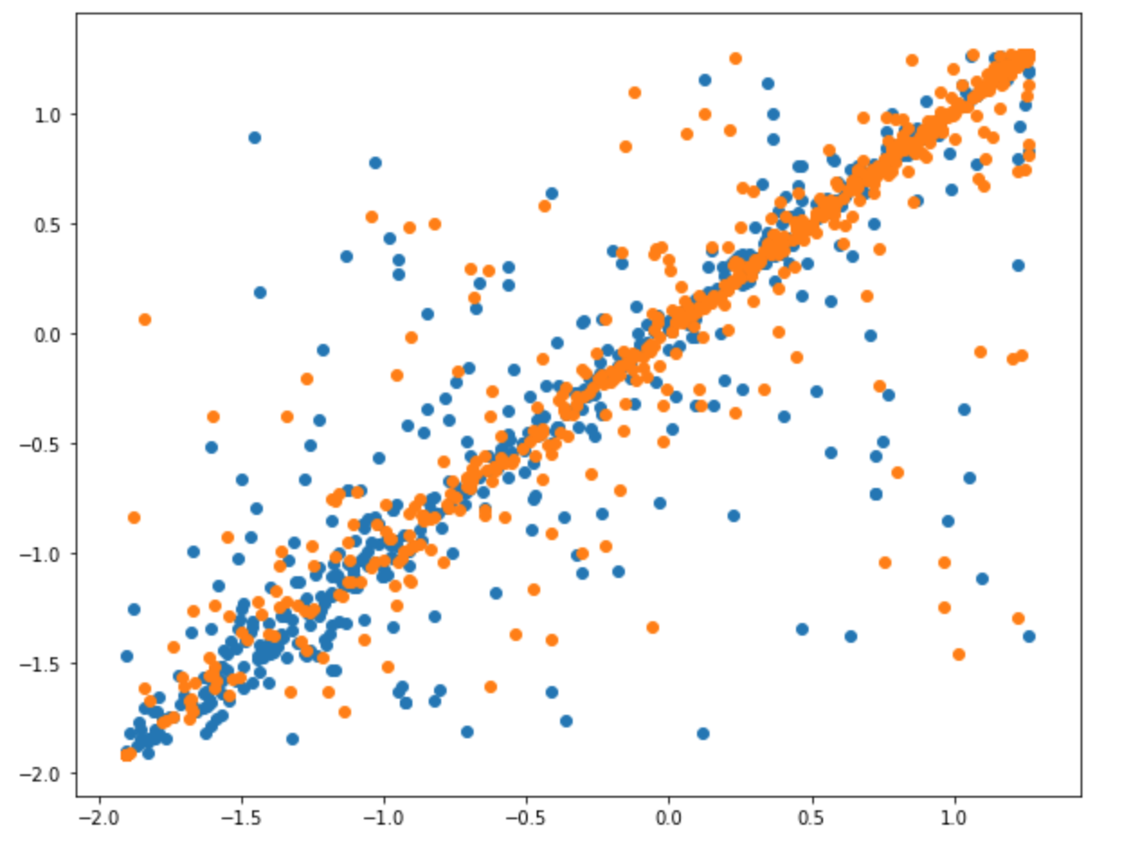
Evaluation Metrics
Using PCA to determine if the images of military and non-military vehicles can be “grouped nicely”

Slide 5
Method
First model (accuracy : 75%)
model.add(Conv2D(32, kernel_size=(3, 3), activation='relu, input_shape=input_shape))
model.add(Conv2D(64, (3, 3), activation='relu'))
model.add(MaxPooling2D(pool_size=(2, 2)))
model.add(Flatten())
model.add(Dense(num_classes, activation='softmax'))
Added more images of green car (accuracy : 76%)
Added one more Conv2D layer (accuracy : 79%)
Change activation to "sigmoid" and binary_crossentropy (accuracy : 76%)

